Slide 1

SLAI
A new way to enjoy orchestra

Slide 2
Market research
Audience demography of Orchestra:
Mainly musician or experts
Increased popularity: 2x more new-joiners
However, 60% of new joiners want a new orchestra experience
[1] https://www.rpo.co.uk/images/articles/2024_insights_report/RPO%20Insights%20Report%20March%202024.pdf

Slide 3
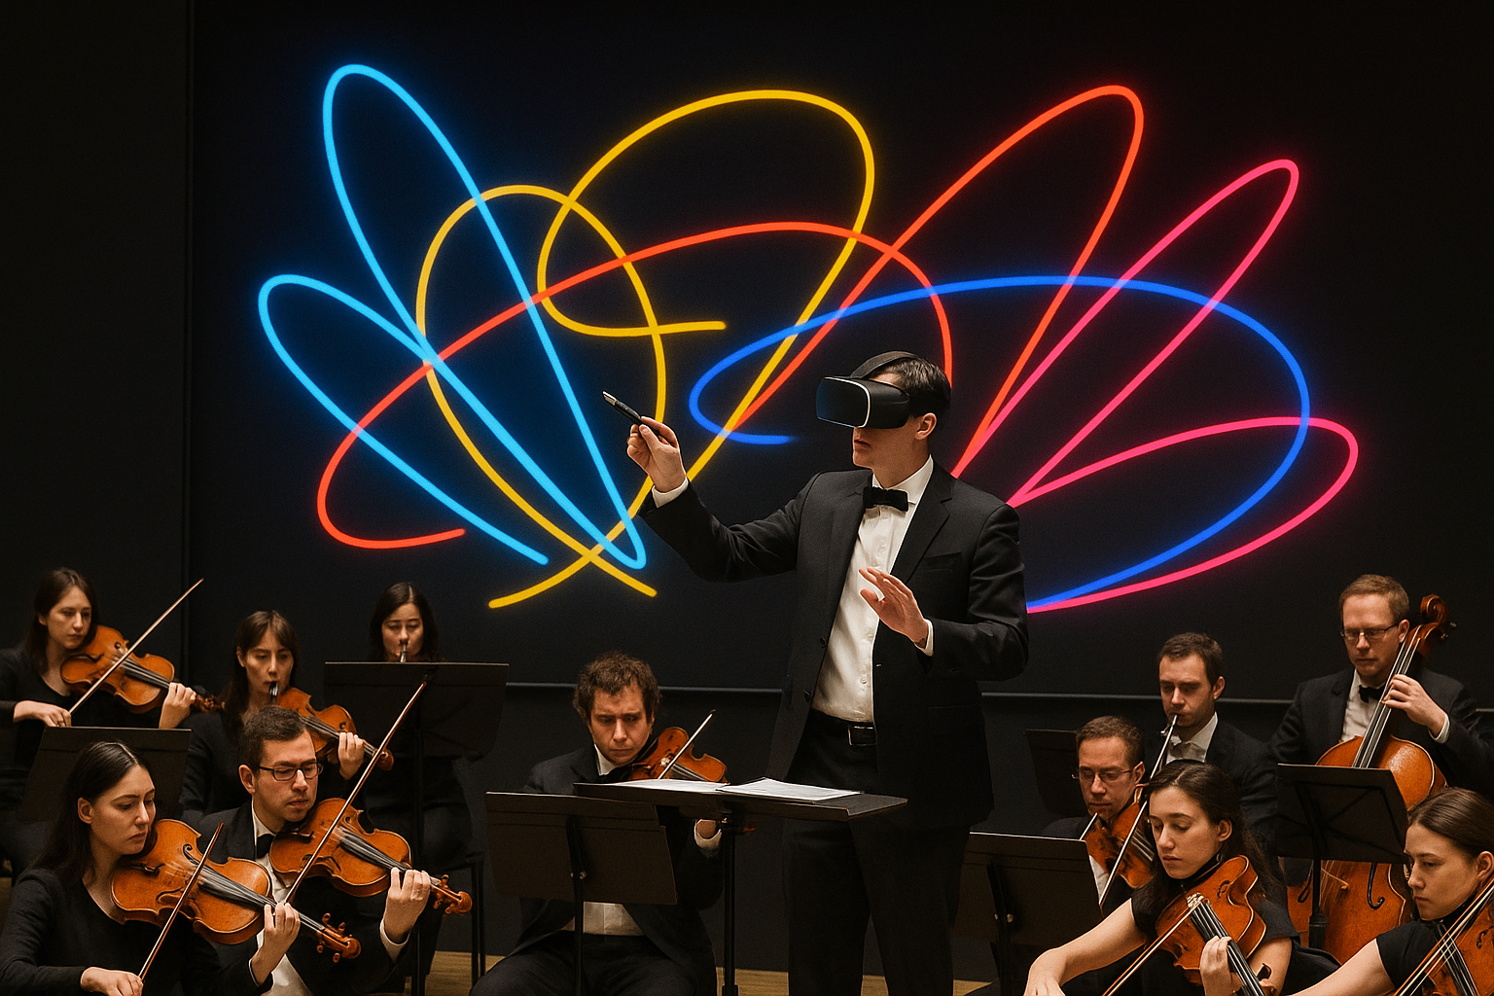
SLAI a new orchestra experience

Slide 4
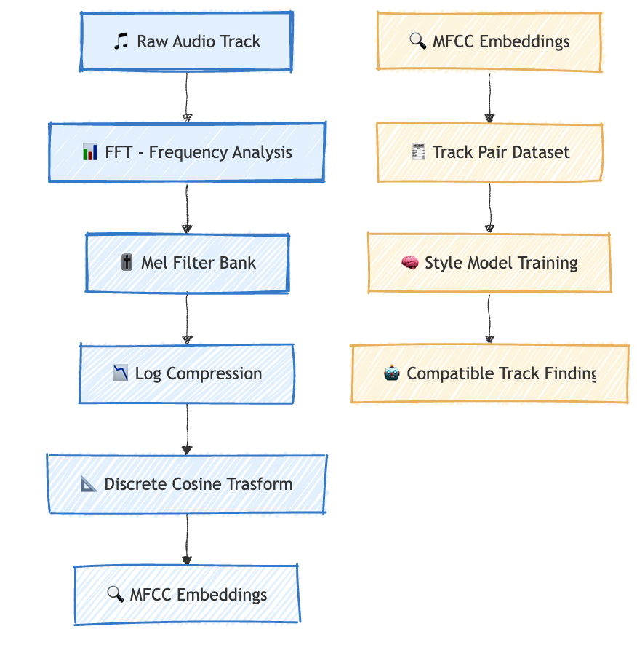
AI

Slide 5

Thank you

